Slide 1
Software Testing Principles and Patterns
Summer 2024

Slide 2
The goal of unit testing
1- The state of unit testing
Many projects have automated tests; they may even have a lot of them, but the existence of those tests often doesn’t provide the results the developers hope for.
The discussion has shifted from “Should we write unit tests?” to “What does it mean to write good unit tests?” This is where the main confusion still lies.

Slide 3
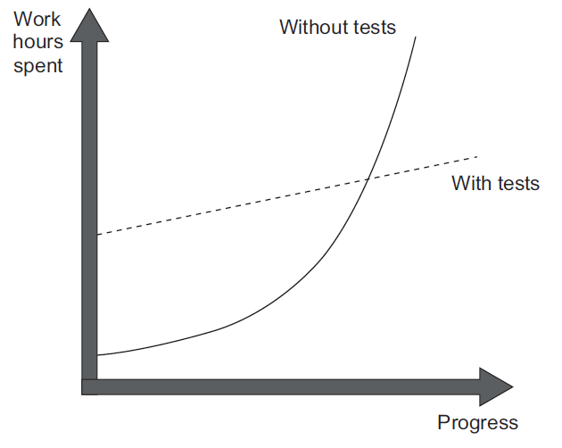
The goal of unit testing
2- The goal of unit testing
Sustainable growth of the software project.
Software entropy:
. Increasingly complex and disorganized
. Fixing one bug introduces more bugs
. modifying one part of the software breaks several others

Slide 4
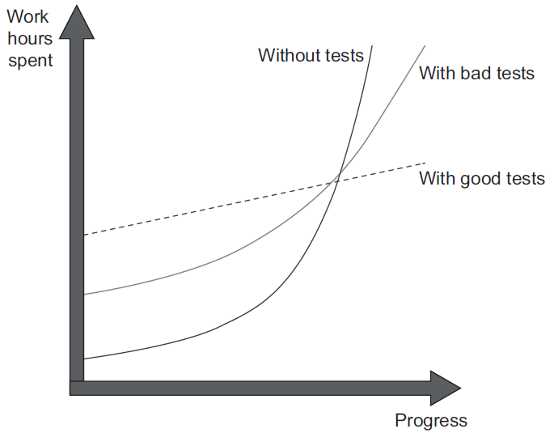
The goal of unit testing
2- The goal of unit testing
What makes a good or bad test?
consider both the test’s value and its upkeep cost.
The cost component is determined by the amount of time spent
on various activities:
. Refactoring the test when you refactor the underlying code
. Running the test on each code change
. Spending time reading the test when you’re trying to
understand how the underlying code behaves

Slide 5
The goal of unit testing
3- Using coverages metrics to measure test suite quality
A coverage metric shows how much source code a test suite executes, from none to 100%.
coverage metrics are a good negative indicator but a bad positive one.
To read more -> go to page 9, book Unit Testing PP

Slide 6

The goal of unit testing
3- Using coverages metrics to measure test suite quality
Understanding Code Coverage metric
To read more -> go to page 9, book Unit Testing PP

Slide 7

The goal of unit testing
3- Using coverages metrics to measure test suite quality
Understanding Branch Coverage metric
To read more -> go to page 11, book Unit Testing PP

Slide 8
The goal of unit testing
3- Using coverages metrics to measure test suite quality
YOU CAN’T GUARANTEE THAT THE TEST VERIFIES ALL THE POSSIBLE OUTCOMES
To read more -> go to page 12, book Unit Testing PP
NO COVERAGE METRIC CAN TAKE INTO ACCOUNT CODE PATHS IN EXTERNAL LIBRARIES
To read more -> go to page 14, book Unit Testing PP

Slide 9
The goal of unit testing
4- Attributes of a successful test suite
The point is that there’s no automated way to see how good your test suite is.
You have to apply your personal judgment.
A successful test suite has the following properties:
It’s integrated into the development cycle.
It targets only the most important parts of your code base.
It provides maximum value with minimum maintenance costs.

Slide 10


What is a unit test?
1- The definition of unit test
A unit test is an automated test that:
Verifies a small piece of code (also known as a unit)
Does it quickly
And does it in an isolated manner

Slide 11
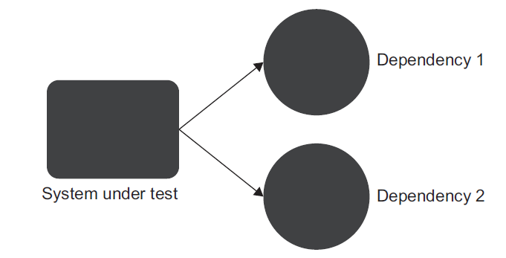
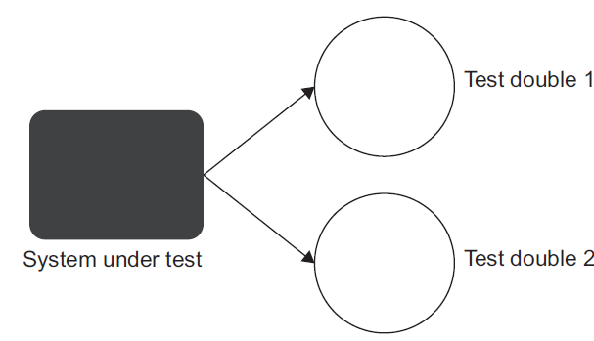
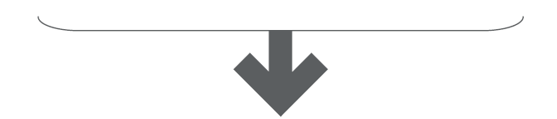
What is a unit test?
1- The definition of unit test
The Isolation issue: The London take
To read more -> go to page 24, book Unit Testing PP

Slide 12
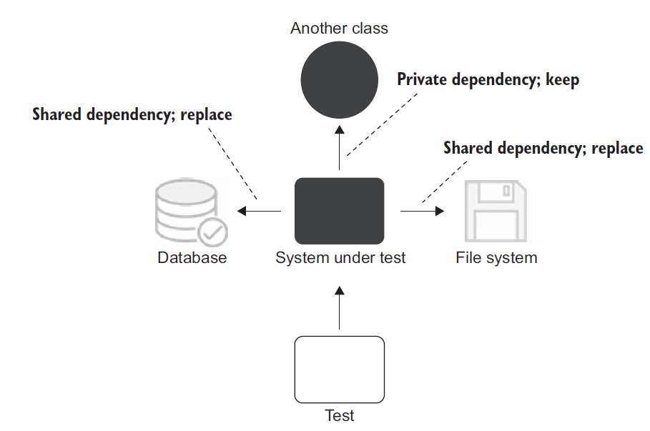
What is a unit test?
1- The definition of unit test
The Isolation issue: The classical take
To read more -> go to page 27, book Unit Testing PP

Slide 13
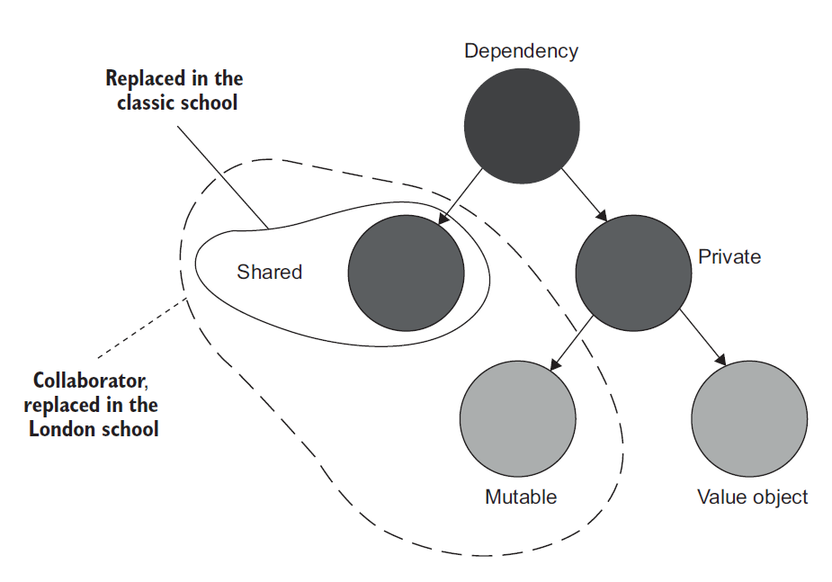
What is a unit test?
2- The classical and London schools of unit testing

Slide 14
What is a unit test?
2- The classical and London schools of unit testing
Collaborator vs. Dependency
customer.Purchase(store, Product.Shampoo, 5)
Here we have three dependencies. One of them (store) is a collaborator, and the other two (Product.Shampoo, 5) are not.

Slide 15
What is a unit test?
3- Contrasting the classical and London schools of unit testing
- Unit testing one class at a time
Observable behavior vs. Internal implementation details
- Unit testing a large graph of interconnected classes
A large class graph is a result of a code design problem
- Revealing the precise bug location
There’s some value in failures cascading all over the test suite

Slide 16
What is a unit test?
3- Contrasting the classical and London schools of unit testing
- Outside-in vs Inside-out
- Over-specification Issue
To read more -> go to page 37, book Unit Testing PP

Slide 17
What is a unit test?
4- Integration tests in the two schools
An integration test is a test that verifies that your code works in integration with shared dependencies, out-of-process dependencies, or code developed by other team in the organization.
Hence the name end-to-end, which means the test verifies the system from the end user’s point of view, including all the external applications this system integrates with.

Slide 18
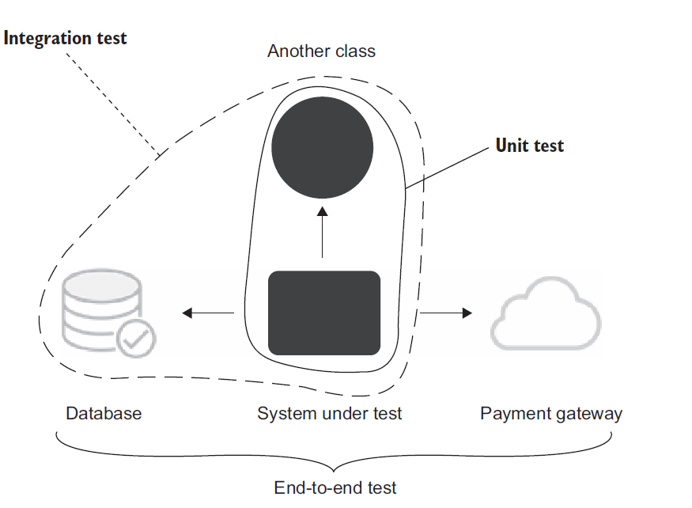
What is a unit test?
4- Integration tests in the two schools

Slide 19
The Anatomy of a Unit Test
1- The structure of a unit test
Using AAA pattern
To read more -> go to page 42, book Unit Testing PP
. Arrange section -> SUT and dependancies
. Act section -> Call method on SUT and capture output
. Assert section -> Verify the outcome

Slide 20
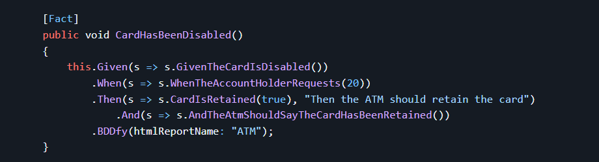
The Anatomy of a Unit Test
1- The structure of a unit test
Using Given, When, Then pattern
To read more, visit the link : https://github.com/TestStack/TestStack.BDDfy

Slide 21
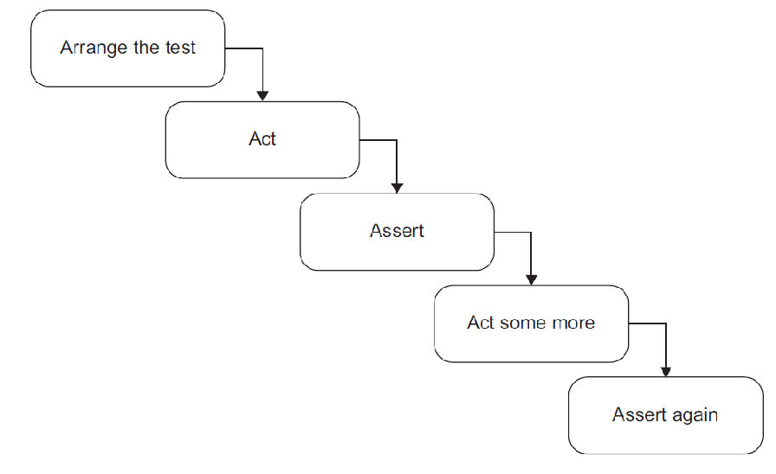
The Anatomy of a Unit Test
1- The structure of a unit test
. Avoid multiple arrange, act and assert sections (except for slow tests)
To read more -> go to page 44, book Unit Testing PP
. Avoid if statements in tests

Slide 22
The Anatomy of a Unit Test
1- The structure of a unit test
. How large should each section be?
. The arrange section is the largest (Object mother and Test Data builder)
. The act section SUT’s public API (invariant violation, encapsulation)
. The assert section (missing abstraction in production code)
To read more -> go to page 45, book Unit Testing PP

Slide 23
The Anatomy of a Unit Test
2- Unit test naming best practices
Using [MethodUnderTest]_[Scenario]_[ExpectedResult]
public void Sum_TwoNumbers_ReturnsSum()
public void Sum_of_two_numbers()
. Separate words by underscores
. Don’t follow a rigid naming policies

Slide 24
The Anatomy of a Unit Test
2- Unit test naming best practices
Renaming a test toward the guidelines
To read more -> go to page 56, book Unit Testing PP

Slide 25
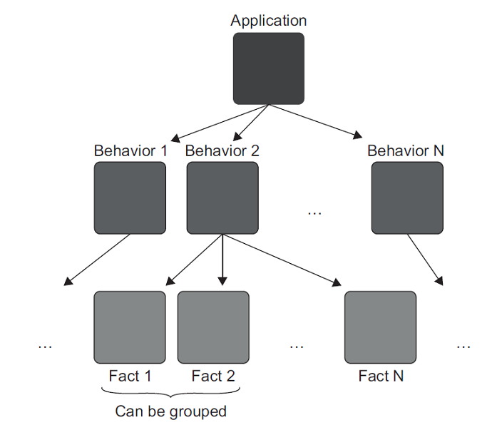
The Anatomy of a Unit Test
3- Working with parameterized tests
Tests are meant to fully describe a unit of behavior.
To read more -> go to page 58, book Unit Testing PP

Slide 26
The four pillars of a good unit test
1- Diving into the four pillar of a good unit test
Protection against regressions
Resistance to refactoring
Fast feedback
Maintainability
To read more -> go to page 68, book Unit Testing PP

Slide 27
The four pillars of a good unit test
1- Diving into the four pillar of a good unit test
Protection against regressions
Regression is a software bug.
To maximize the metric of protection against regressions, the test needs to aim at exercising as much code as possible.
To read more -> go to page 69, book Unit Testing PP

Slide 28
The four pillars of a good unit test
1- Diving into the four pillar of a good unit test
Resistance to refactoring
The degree to which a test can sustain a refactoring of the underlying application code without
turning red (failing).
Refactoring means changing existing code without modifying its observable behavior.
First, developers take test failures at face value and deal with them accordingly. After a while, people get tired of tests crying “wolf” all the time and start to ignore them more and more.
To read more -> go to page 71, book Unit Testing PP

Slide 29
The four pillars of a good unit test
1- Diving into the four pillar of a good unit test
Resistance to refactoring
The only way to reduce the chance of getting a false positive is to decouple the test from those implementation details.
The best way to structure a test is to make it tell a story about the problem domain.
To read more -> go to page 75, book Unit Testing PP

Slide 30
The four pillars of a good unit test
1- Diving into the four pillar of a good unit test
Fast feedback
and
Maintainability
How fast you can run the tests?
How hard it is to read the tests?
How hard it is to run the tests?
To read more -> go to page 79, book Unit Testing PP

Slide 31
The four pillars of a good unit test
2- In search of an ideal test
Protection against regressions
Resistance to refactoring
Fast feedback
Maintainability
Value estimate = [0..1] * [0..1] * [0..1] * [0..1]
To read more -> go to page 81, book Unit Testing PP

Slide 32
The four pillars of a good unit test
2- In search of an ideal test
. Is it possible to create an ideal test?
Value estimate = [0..1] * [0..1] * [0..1] * [0..1]
Unfortunately, it’s impossible to create an ideal test. first three attributes—protection against regressions, resistance to refactoring, and fast feedback—are mutually exclusive. It’s impossible to maximize them all: you have to sacrifice one of the three in order to max out the remaining two.
To read more -> go to page 81, book Unit Testing PP

Slide 33
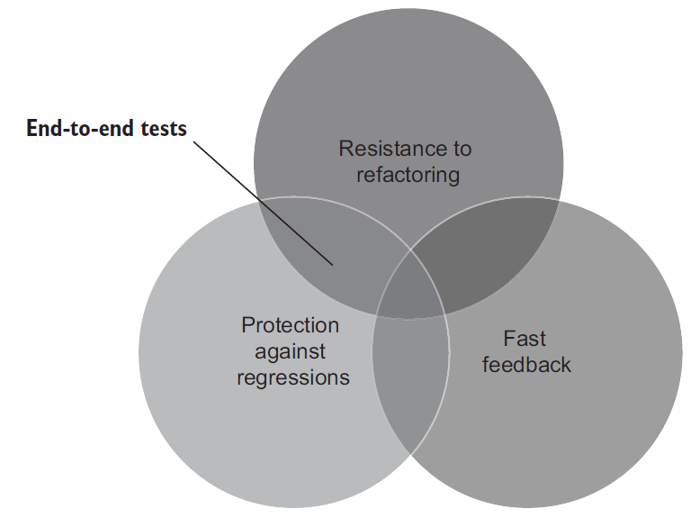
The four pillars of a good unit test
2- In search of an ideal test
. Extreme case 1: End-to-End tests
To read more -> go to page 81, book Unit Testing PP

Slide 34
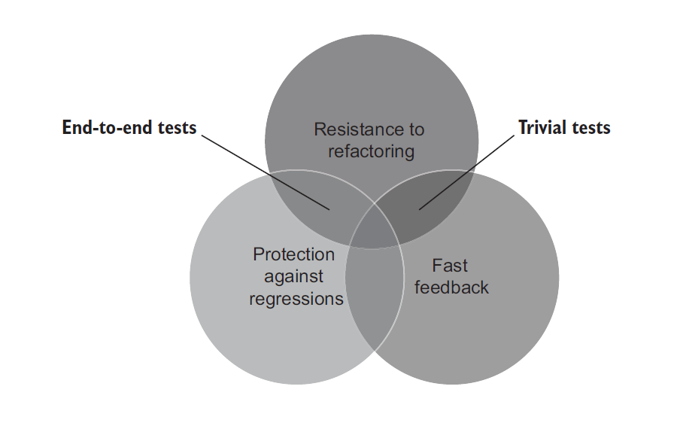
The four pillars of a good unit test
2- In search of an ideal test
. Extreme case 2: Trivial tests
To read more -> go to page 81, book Unit Testing PP

Slide 35
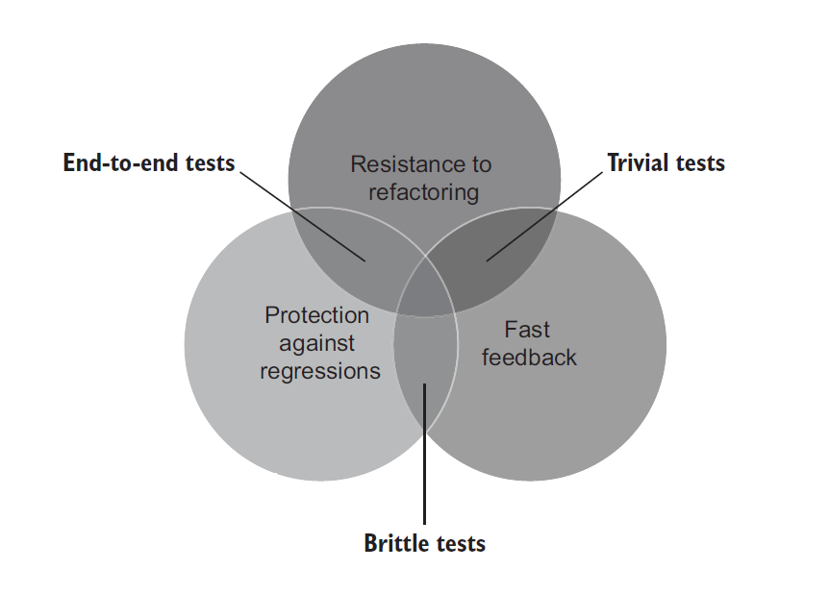
The four pillars of a good unit test
2- In search of an ideal test
. Extreme case 3: Brittle tests
To read more -> go to page 84, book Unit Testing PP

Slide 36
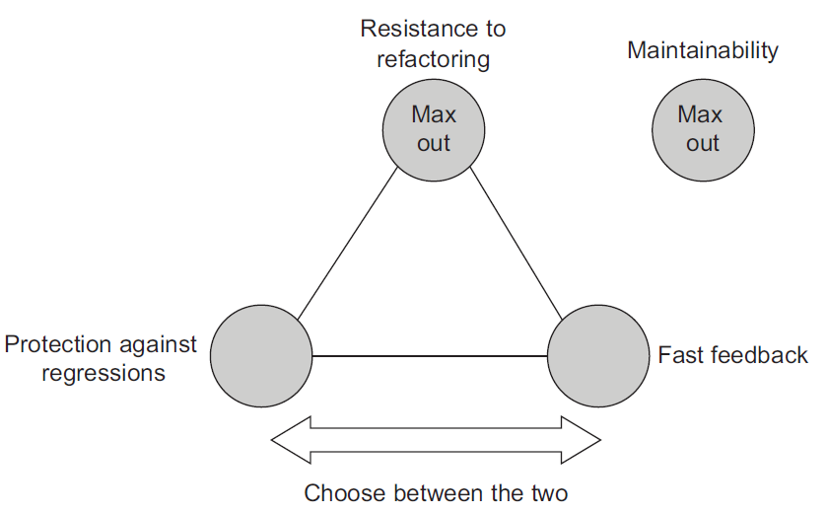
The four pillars of a good unit test
2- In search of an ideal test
. The results
To read more -> go to page 85, book Unit Testing PP

Slide 37
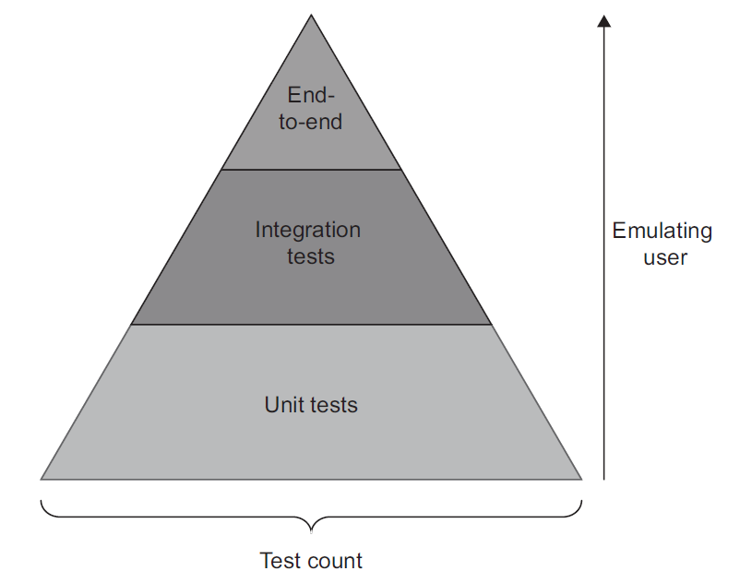
The four pillars of a good unit test
3- Well-known test automaton concepts
. The Test Pyramid
To read more -> go to page 85, book Unit Testing PP

Slide 38
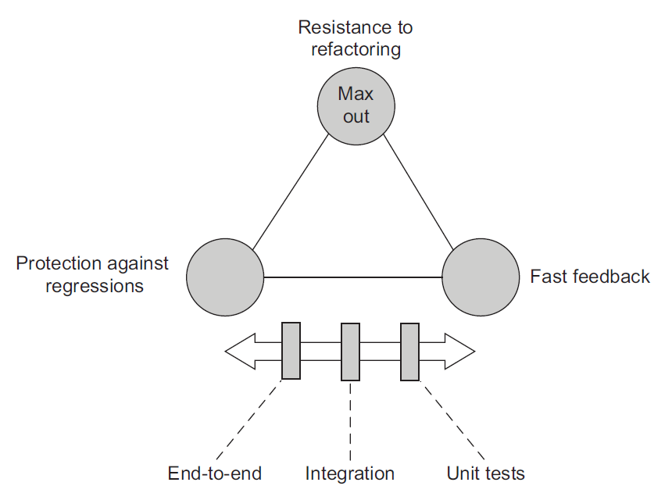
The four pillars of a good unit test
3- Well-known test automaton concepts
. The Test Pyramid
To read more -> go to page 88, book Unit Testing PP

Slide 39
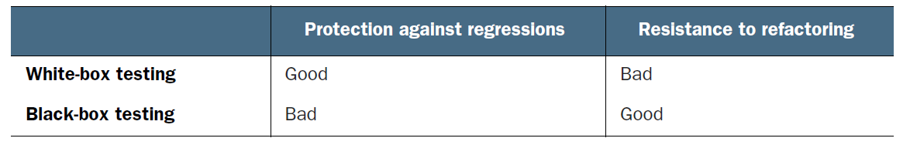
The four pillars of a good unit test
3- Well-known test automaton concepts
Black-box testing is a method of software testing that examines the functionality of a system without knowing its internal structure. Such testing is normally built around specifications and requirements: what the application is supposed to do, rather than how it does it.
White-box testing is the opposite of that. It’s a method of testing that verifies the application’s inner workings. The tests are derived from the source code, not requirements or specifications.

Slide 40
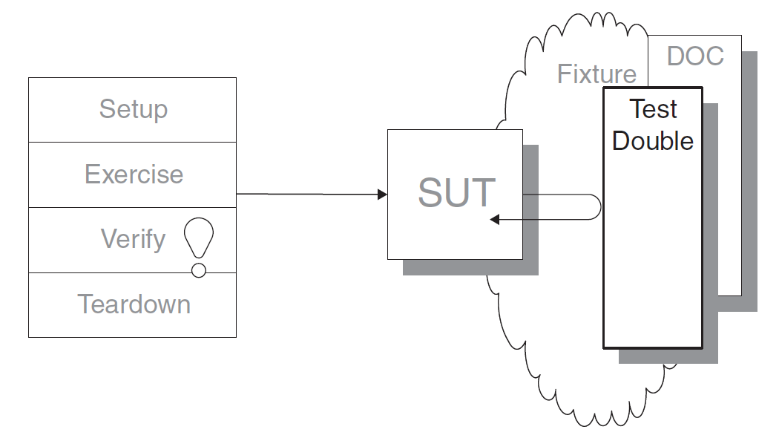
Test Double Patterns
1- Test Double
How can we verify logic independently when code it depends on is unusable?
How can we avoid Slow Tests?
We replace a component on which the SUT
depends with a“test-specifi c equivalent.”

Slide 41
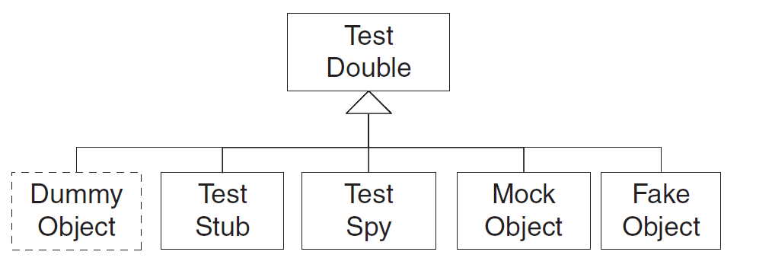
Test Double Patterns
Test Double
. These variations are classified based on how/why we use the Test Double.

Slide 42
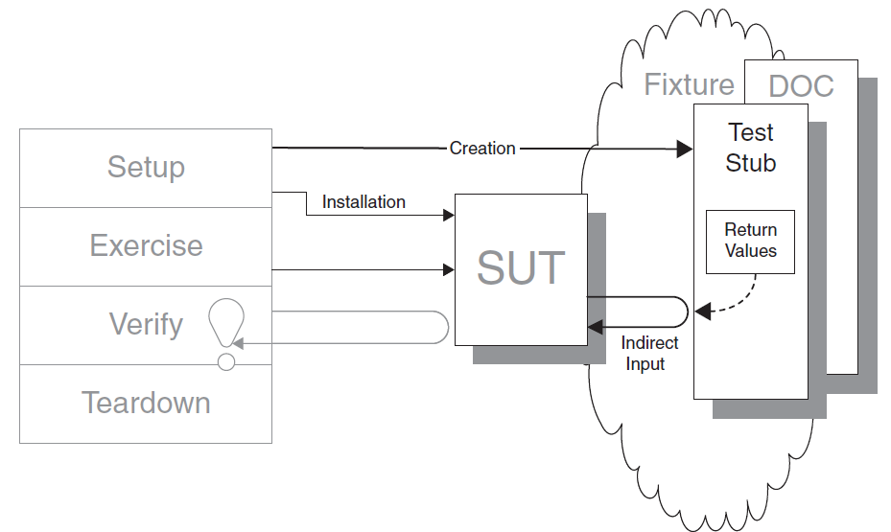
Test Double Patterns
1- Test Stub
How can we verify logic independently when it depends on indirect inputs from other software components?

Slide 43
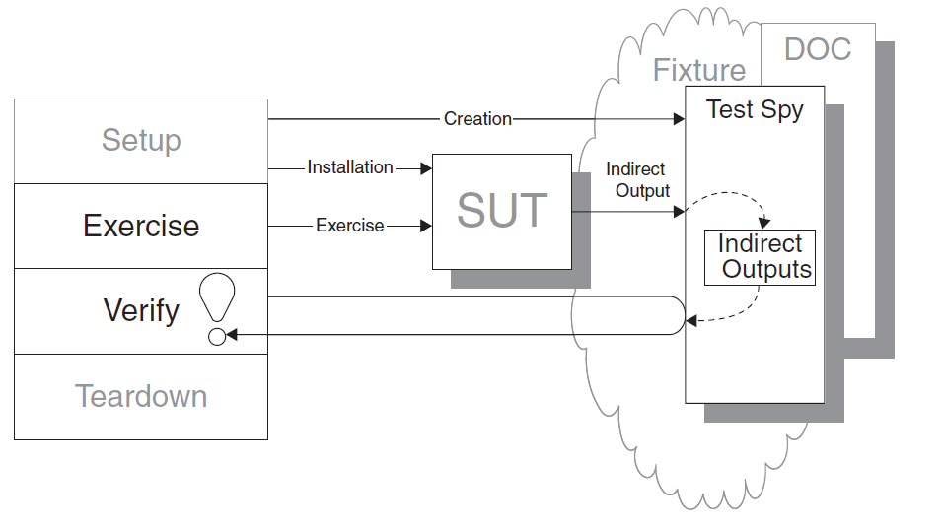
Test Double Patterns
2- Test Spy
How can we verify logic independently when it has indirect outputs to other software components?

Slide 44
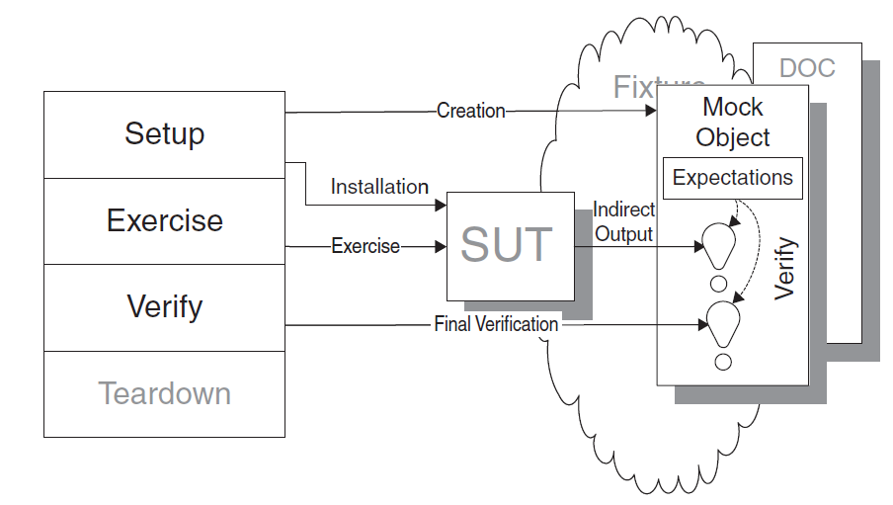
Test Double Patterns
3- Mock Object
How can we verify logic independently when it depends on indirect inputs from other software components?

Slide 45
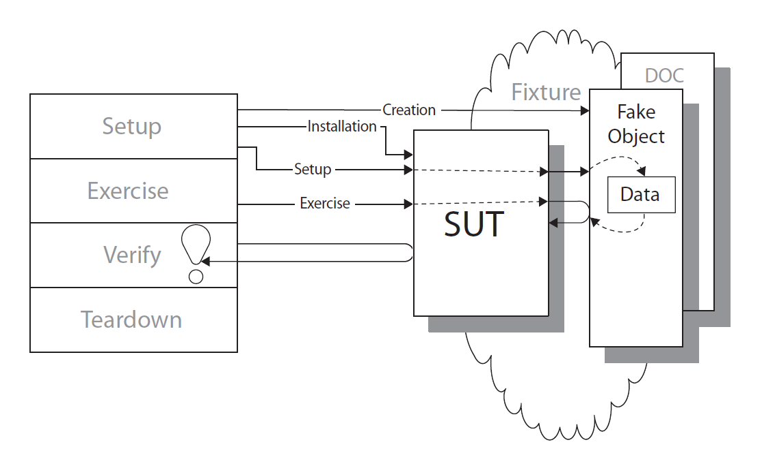
Test Double Patterns
4- Fake Object
How can we verify logic independently when depended-on objects cannot be used?

Slide 46
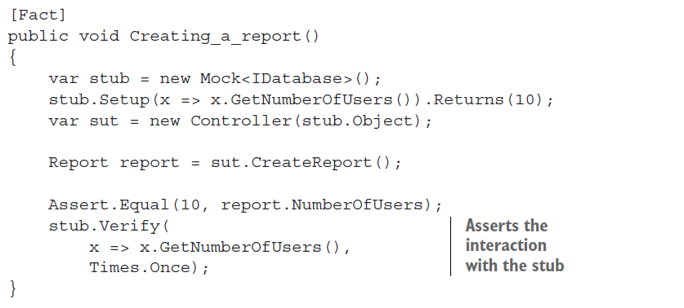
Mocks and Test Fragility
1- Don’t assert interactions with stubs
Asserting interactions with stubs is a common anti-pattern that leads to fragile tests.

Slide 47
Mocks and Test Fragility
1- Don’t assert interactions with stubs
This practice of verifying things that aren’t part of the end result is also called overspecification.

Slide 48
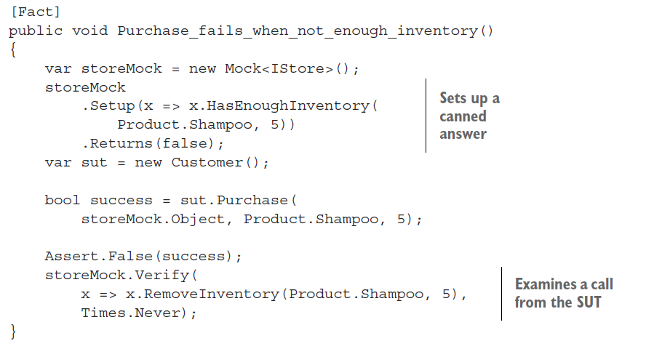
Mocks and Test Fragility
2- Using stubs and mocks together

Slide 49
Mocks and Test Fragility
3- Observable behavior vs. Implementation details
Observable behavior is not the same as a public API
For a piece of code to be part of the system’s observable behavior, it has to do one of the following things:
Expose an operation that helps the client achieve one of its goals. An operation is a method that performs a calculation or incurs a side effect or both.
Expose a state that helps the client achieve one of its goals. State is the current condition of the system.

Slide 50
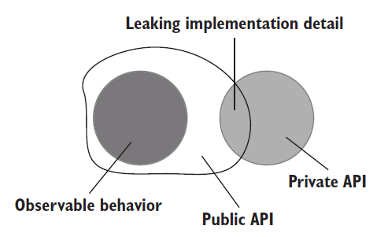
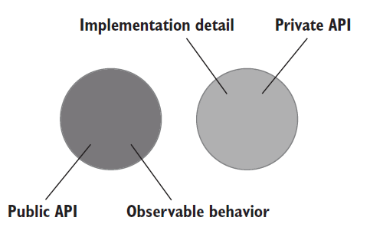
Mocks and Test Fragility
3- Observable behavior vs. Implementation details
Leaking implementation details (With code examples: operation + state)

Slide 51
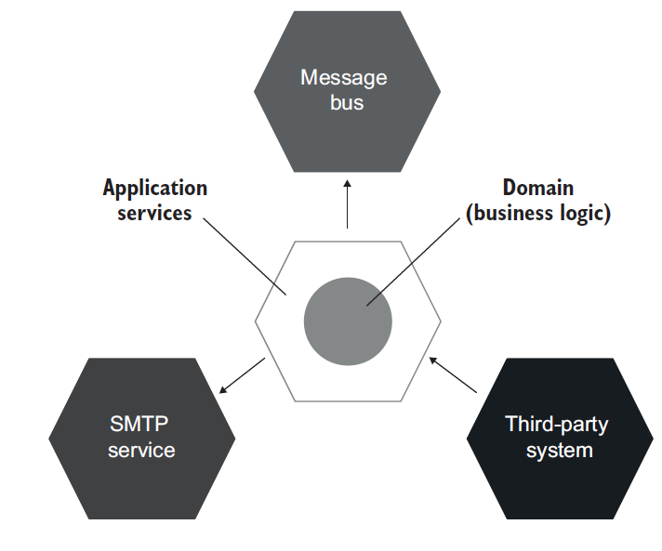
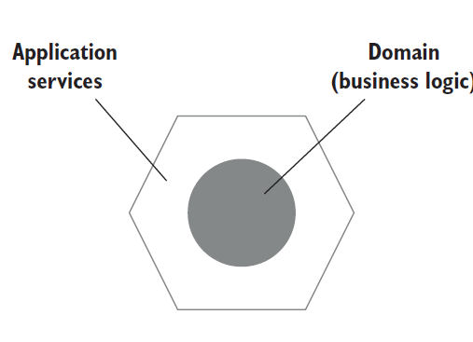
Mocks and Test Fragility
4- The relationship between mocks and test fragility
Defining hexagonal architecture

Slide 52
Styles of Unit Testing

Slide 53
Styles of Unit Testing
The three styles of unit testing
. Output-based testing
. State-based testing
. Communication-based testing

Slide 54
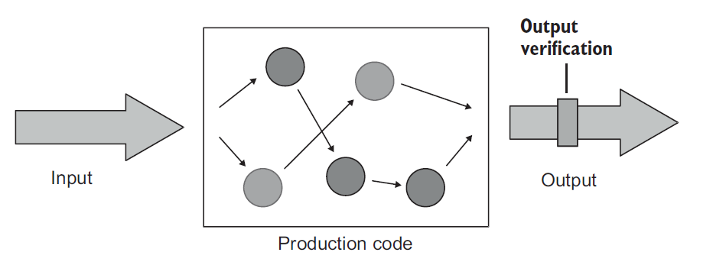
Styles of Unit Testing
1-Defining the output-based style
This style of unit testing is only applicable to code that doesn’t change a global or internal state, so the only component to verify is its return value (side-effect-free code).

Slide 55
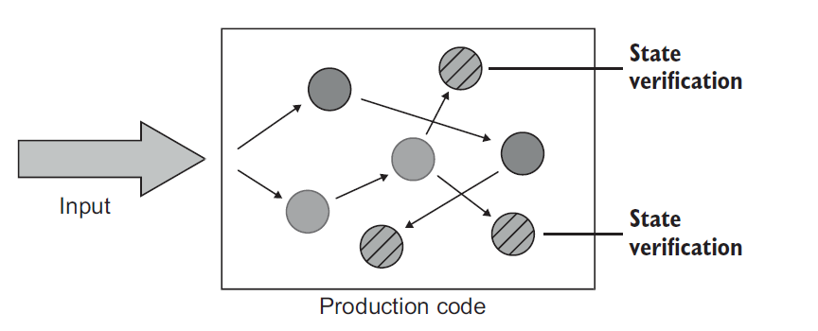
Styles of Unit Testing
2-Defining the state-based style

Slide 56
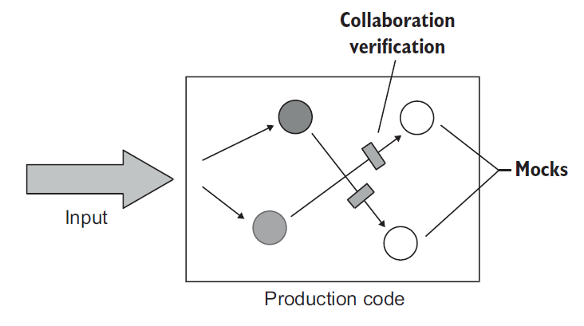
Styles of Unit Testing
3-Defining the communication-based style
This style uses mocks to verify communications between the system under test and its collaborators.

Slide 57
Refactoring toward valuable unit tests

Slide 58
Styles of Unit Testing
1- Identifying the code to refactor
. All production code can be categorized along two dimensions:
Complexity or domain significance
The number of collaborators

Slide 59
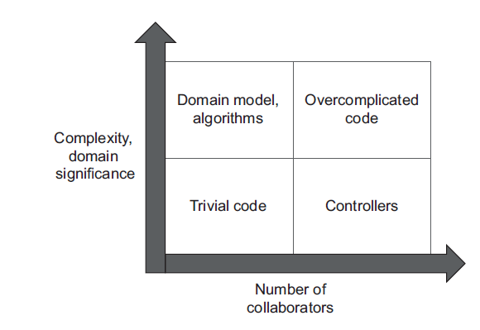
Styles of Unit Testing
1- Identifying the code to refactor
The combination of code complexity, its domain significance, and the number of collaborators give us the four types of code.

Slide 60
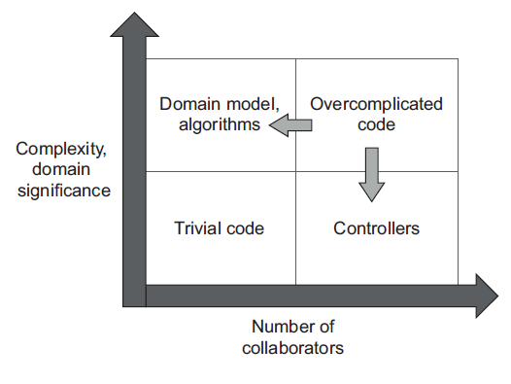
Styles of Unit Testing
1- Identifying the code to refactor
The more important or complex the code, the fewer collaborators it should have.

Slide 61
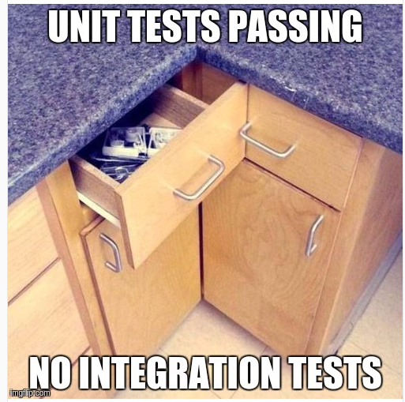
Why Integration Testing?

Slide 62
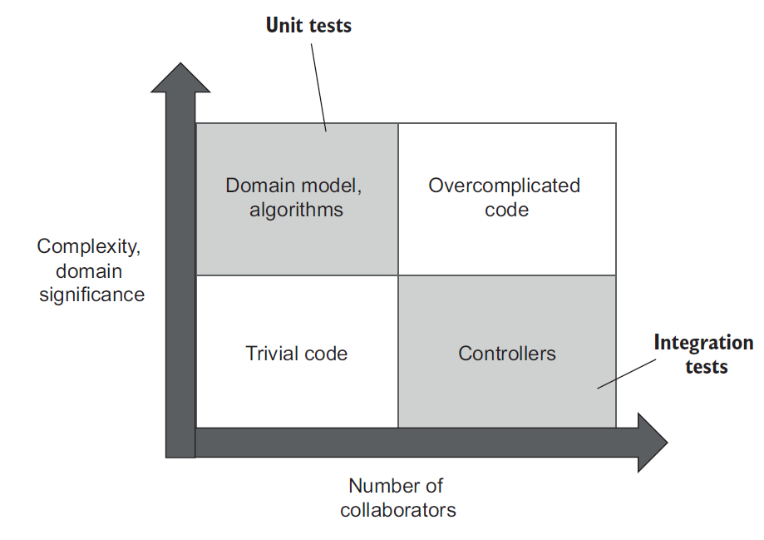
Why Integration Testing?
1- The role of integration tests

Slide 63
Why Integration Testing?
2- The test Pyramid revisited
Check as many of the business scenario’s edge cases as possible with unit tests; use integration tests to cover one happy path, as well as any edge cases that can’t be covered by unit tests.
For an integration test, select the longest happy path in order to verify interactions with all out-of-process dependencies.

Slide 64
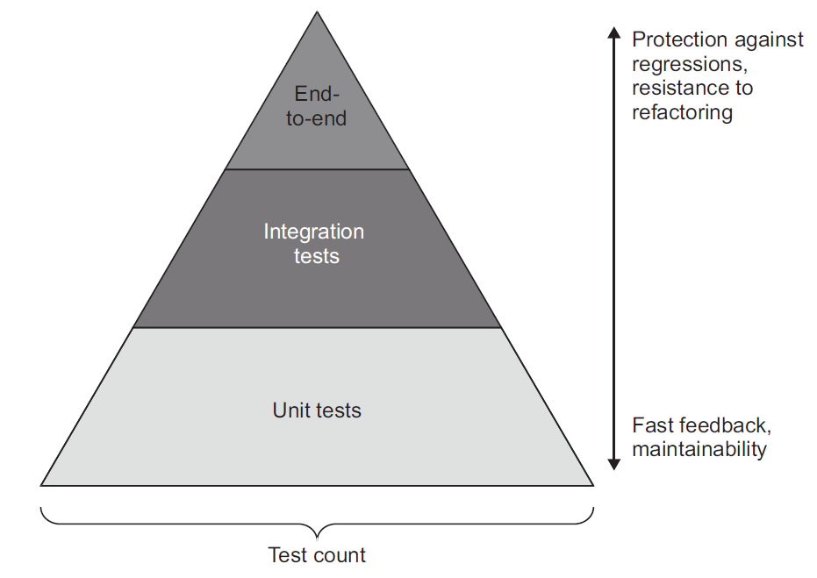
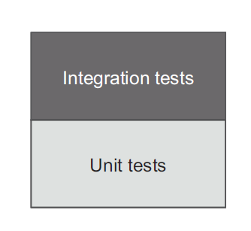
Why Integration Testing?
3- The test Pyramid revisited

Slide 65
Why Integration Testing?
4- Testing out-of-process dependencies
All out-of-process dependencies fall into two categories:
. Managed dependencies (out-of-process dependencies you have full control over)
. Unmanaged dependencies (out-of-process dependencies you don’t have full control over)
Use real instances of managed dependencies; replace unmanaged dependencies with mocks.

Slide 66
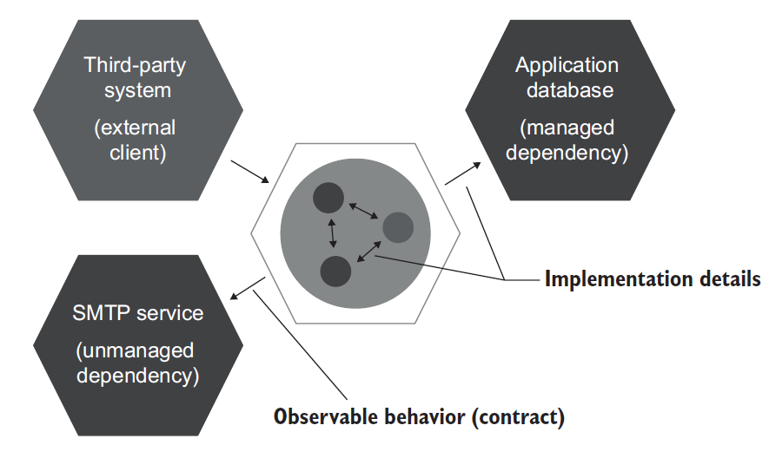
Why Integration Testing?
4- Testing out-of-process dependencies

Slide 67
Why Integration Testing?
4- Testing out-of-process dependencies
What if you can’t use a real database in integration tests?

Slide 68
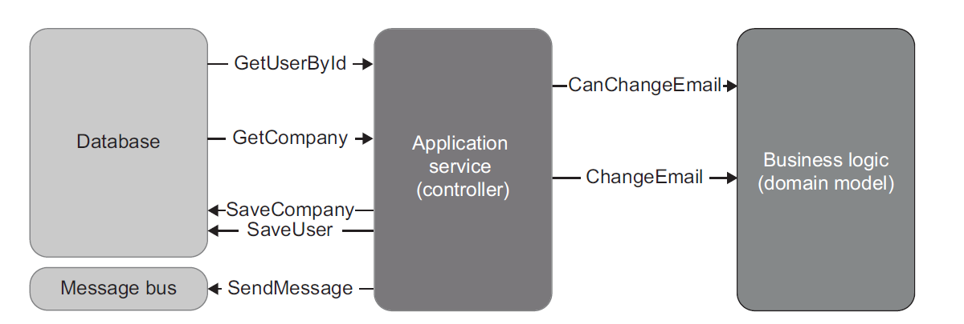
Why Integration Testing?
5- Integration testing: An example

Slide 69
Mocking best Practices
1- Verifying interactions at the system edges
Mocking the very last type that communicates with the unmanaged dependency increases the number of classes the integration test goes through and thus improves the protection.

Slide 70
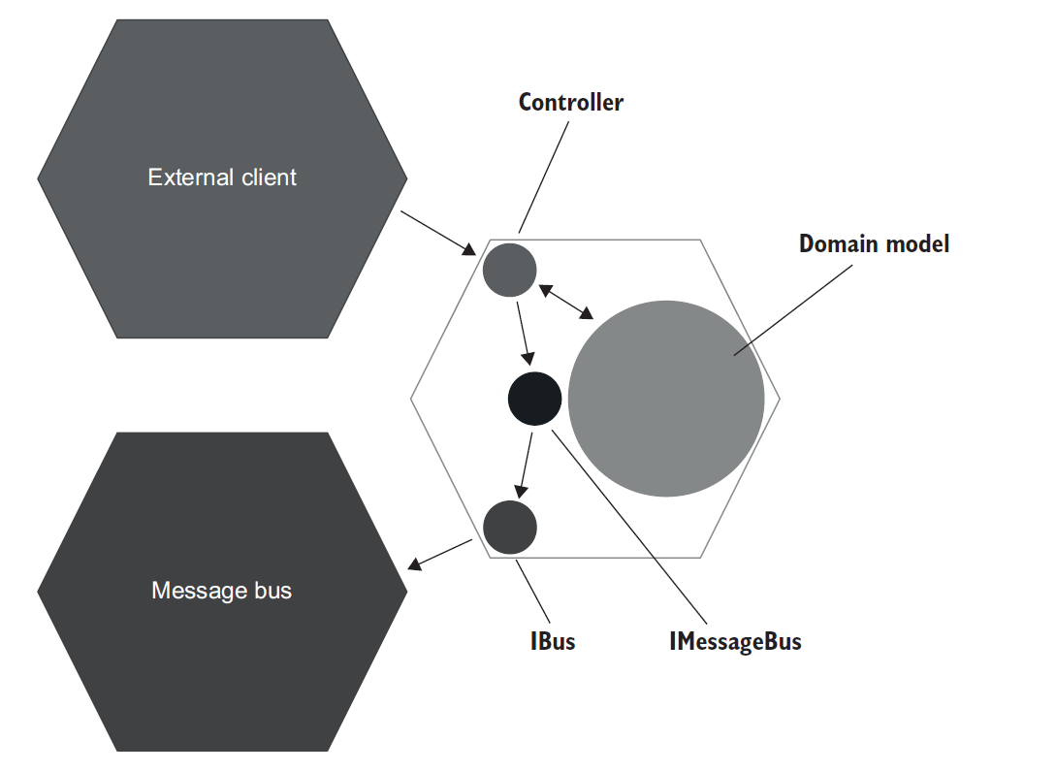
Mocking best Practices
1- Verifying interactions at the system edges

Slide 71
Mocking best Practices
1- Verifying interactions at the system edges
Applying mocks to unmanaged dependencies only
Verifying the interactions with those dependencies at the very edges of your system
Using mocks in integration tests only, not in unit tests
Always verifying the number of calls made to the mock

Slide 72
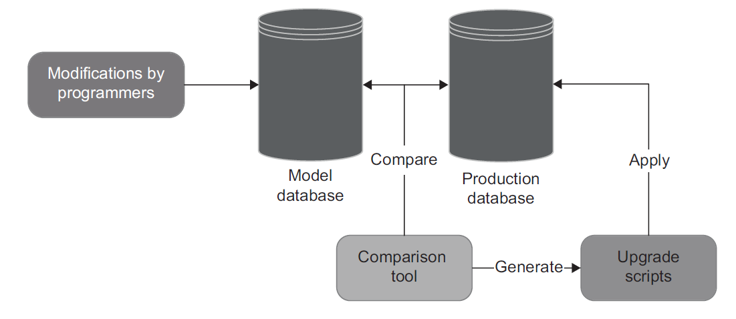
Testing the Database
1- Prerequisites for testing the database
Keeping the database in the source control system

Slide 73
Testing the Database
1- Prerequisites for testing the database
Reference data is part of the database schema
If your application can modify the data, it’s regular data; if not, it’s reference data.

Slide 74
Testing the Database
1- Prerequisites for testing the database
Separate instance for every developer
The use of a shared database hinders the development process because:
Tests run by different developers interfere with each other.
Non-backward-compatible changes can block the work of other developers.

Slide 75
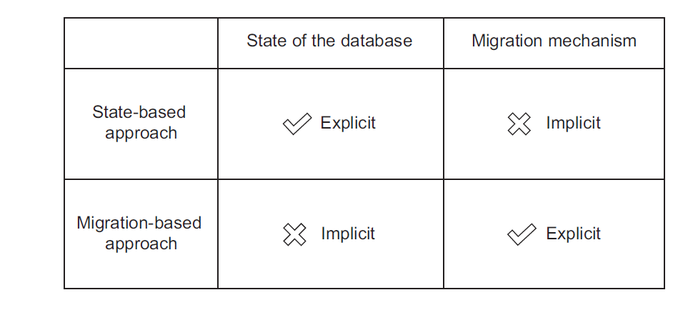
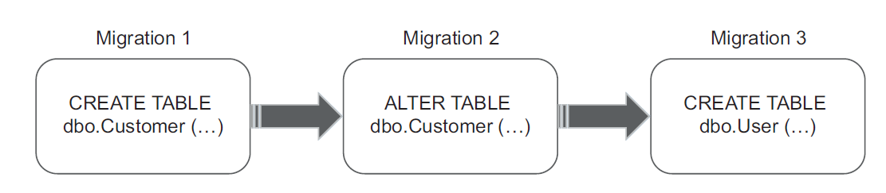
Testing the Database
1- Prerequisites for testing the database
State-based vs. migration-based database delivery

Slide 76
Testing the Database
2- Database transaction management
Managing database transactions in production code

